Slide 1
OBJECT DETECTION

Slide 2
PROJECT GOAL
GOAL 1:
Build a REST api endpoint such that satellite image can be sent to this REST endpoint and it can return the result as - whether the image contains ship or not.
EXTENDED GOAL:
Segmentation data indicating which pixels belong to the ship

Slide 3
ETL STRATEGY

Slide 4
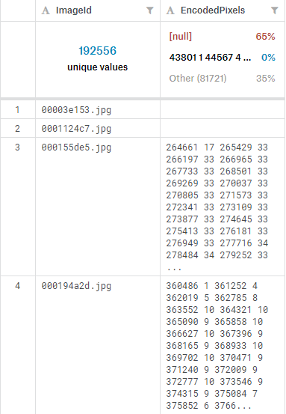
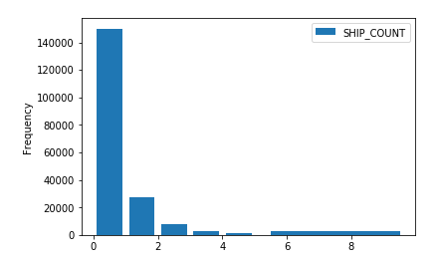
Raw Data from Train Data Set
Total number of rows in raw file - 231723
Number of rows with image - 192556
Number of images contain one or more ships - 42556(22%)
Number of images with no ship - 150000(78%)

Slide 5
MODELING STRATEGY
Data Handling
The data exists on the Kaggle website. We are going to download the data locally and then upload it to an S3 bucket 'objectdetectchicagoteam2'
train_ship_segmentations_v2.csv file contains Run Length Encoded masks. We are going to use presence of data to determine if an image contains ship or not
There could be multiple rows for a given image if it contains multiple ships. We'll ignore multiple rows for the same image for the 1st part
Image classification problem We are going to use Sagemaker's image classification built-in algorithm to solve this problem. Considering the time and resources available to us, we'll be using partial data from train_v2.zip file to train the model as two class classification problem, indicating SHIP or NO_SHIP. The output will also indicate the classification confidence.

Slide 6
APPROACH
Created 3 train, validation and test data set with 4000, 8000 and 16000 images respectively with a balanced distribution of ships and no ships.
Trained and validated with 3 different data sets
Finally tested the model with 4000 images with balanced distribution
Interpreted accuracy with epochs, loss function and confusion matrix

Slide 7
EPOCHS and ACCURACY

Slide 8
LOSS FUNCTION

Slide 9
CONFUSION MATRIX
True Positive False Positive
898 57
False Negative True Negative
102 943

Slide 10
INTERPRETATION OF RESULTS

